Slide 1
Carbon-Aware Task Scheduling Reducing AI Carbon Emissions
Ansh Bansal – 2210990131
Supervised By
Dr. Gurpreet Singh
Department of Computer Science and Engineering,
Chitkara University, Punjab

Slide 2
Title Slide
This presentation explores the concept of carbon-aware task scheduling within distributed computing systems, with a specific focus on reducing the environmental impact of large-scale AI workloads. As modern artificial intelligence models require significant computational power, they consume vast amounts of electricity, much of which is generated from carbon-intensive sources.
The core idea behind this research is to shift from traditional performance-driven scheduling to environmentally conscious scheduling. Instead of executing tasks immediately, the system intelligently determines the optimal time to run them based on real-time electricity grid conditions. Since the carbon intensity of electricity fluctuates throughout the day depending on the mix of energy sources—such as renewable energy versus fossil fuels—this approach allows tasks to be executed when cleaner energy is available.
By integrating live carbon intensity data into scheduling decisions, the system ensures that high-energy tasks are aligned with periods of lower environmental impact. Importantly, this method does not require any changes to existing hardware infrastructure. It is purely a software-based solution, making it cost-effective, scalable, and easy to adopt.
Overall, this approach demonstrates that significant reductions in carbon emissions can be achieved simply by being more flexible with execution timing, offering a practical pathway toward more sustainable and responsible computing.

Slide 3
Abstract
Artificial intelligence models, especially large-scale deep learning systems, require enormous computational resources for training and execution. This leads to high electricity consumption, much of which is generated from carbon-intensive sources like coal and natural gas, significantly contributing to global carbon emissions and environmental degradation.
This research introduces the concept of carbon-aware scheduling as an effective solution to this problem. Instead of executing tasks immediately, the system monitors the carbon intensity of the electricity grid in real time and decides whether to run, delay, or pause workloads accordingly. When the grid is powered by cleaner energy sources such as wind or solar, tasks are executed. During periods of high carbon intensity, tasks are temporarily paused using checkpointing, ensuring no loss of progress.
By aligning computational workloads with cleaner energy availability, the system achieves a reduction in carbon emissions of up to 25%, without changing the total energy consumed. This highlights that smarter timing, rather than reduced usage, can significantly lower environmental impact. Overall, the approach provides a practical, scalable, and cost-effective solution for making AI systems more sustainable.

Slide 4
Introduction
Most modern computing systems are designed with a primary focus on performance and speed, meaning tasks are executed as soon as they are received, without considering the environmental impact of the energy being used. This approach can lead to higher carbon emissions, especially when the electricity powering these systems comes from fossil fuel–based sources.
However, the carbon intensity of electricity is not constant throughout the day. It fluctuates depending on the availability of renewable energy sources such as solar and wind. For example, energy may be cleaner during sunny afternoons or windy periods, and more carbon-intensive during peak demand times or when renewables are unavailable.
This research emphasizes that many AI and data-processing tasks are not time-sensitive and can be delayed without affecting overall outcomes. By identifying these flexible workloads, systems can schedule their execution during periods when cleaner energy is available.
By shifting task execution to these low-carbon windows, the system significantly reduces overall carbon emissions while maintaining efficiency, demonstrating that smarter scheduling can balance performance with environmental responsibility.

Slide 5
Core Concept
The core idea of this system is to align the execution of computational tasks with periods when the electricity grid is powered by cleaner energy sources such as solar, wind, or hydroelectric power. Instead of continuously running tasks regardless of energy conditions, the system actively monitors the grid’s carbon intensity in real time. When renewable energy is abundant and the carbon footprint is low, tasks are allowed to run. Conversely, when the grid relies more heavily on fossil fuels like coal or natural gas, the system pauses execution to avoid contributing to higher emissions.
This approach introduces carbon intensity as an important scheduling factor, similar to traditional computing resources like CPU usage, memory availability, or network bandwidth. By treating environmental impact as a measurable and manageable constraint, the system can make more informed decisions about when to execute workloads.
As a result, scheduling becomes not only performance-driven but also environmentally responsible. This enables organizations to significantly reduce their carbon footprint without changing the amount of work performed, simply by optimizing when that work is done.

Slide 6
Literature Review
Traditional green computing approaches mainly focus on improving the energy efficiency of hardware components, such as designing low-power processors, optimizing cooling systems, or upgrading data center infrastructure. While these methods can reduce overall energy consumption, they often require significant financial investment and are not always feasible for smaller organizations or existing systems.
In contrast, recent research has introduced the concept of carbon-aware computing, which shifts the focus from how much energy is consumed to when that energy is used. Since the carbon intensity of electricity varies throughout the day, adjusting the timing of computational tasks can significantly reduce emissions without reducing performance capacity.
However, many existing carbon-aware solutions are complex, involving advanced optimization models or requiring deep system integration, making them difficult to implement in real-world scenarios. This study addresses that challenge by proposing a simplified approach based on basic rule-based logic and real-time carbon data. By doing so, it makes carbon-aware scheduling more practical, cost-effective, and accessible for a wide range of users and organizations.

Slide 7
Methodology
The system operates by continuously collecting real-time carbon intensity data from the WattTime API, which provides a key metric known as MOER (Marginal Operating Emissions Rate). This metric represents the amount of additional carbon emissions produced for each extra unit of electricity consumed at a given moment, effectively acting as a real-time indicator of how “clean” or “dirty” the grid is.
Using this data, the scheduler follows a simple rule-based approach. When the MOER value is low—indicating that the grid is powered largely by renewable energy sources—the system allows tasks to run. When the MOER value rises, signaling higher reliance on fossil fuels, the system pauses execution to avoid unnecessary emissions.
To ensure efficiency and prevent loss of work, the system useas a checkpointing mechanism. This allows tasks to save their current state before pausing and resume from the same point later, rather than restarting from the beginning. This combination of real-time data and simple logic makes the system both effective and practical for reducing carbon impact.

Slide 8
System Architecture
The system architecture follows a structured pipeline that integrates environmental awareness into every stage of task execution. It begins with task submission, where a user or system requests the execution of a computational workload. Once submitted, the system immediately retrieves real-time carbon intensity data from an external source, such as the WattTime API, to understand current grid conditions.
This data is then passed to the scheduler, which acts as the decision-making component. Based on predefined rules—such as whether the carbon intensity is low or high—the scheduler determines whether the task should begin execution, continue running, or be temporarily paused. When high-carbon conditions are detected, the system uses a checkpointing mechanism to save the current progress of the task, allowing it to resume later without restarting.
As the task executes, the system continuously monitors and records emissions by combining energy usage with carbon intensity data. This end-to-end pipeline ensures that tasks are executed efficiently while actively minimizing their environmental impact, achieving a balance between performance and sustainability.

Slide 9
Results- Carbon Reduction
The implementation of the carbon-aware scheduler resulted in a substantial reduction in carbon emissions, achieving savings of approximately 22% to 25% compared to traditional scheduling methods. This improvement is particularly significant because it was achieved without altering the computational workload or requiring additional resources. Instead, the reduction comes purely from intelligently selecting when tasks are executed based on the carbon intensity of the electricity grid.
These results clearly demonstrate that execution timing plays a crucial role in determining the environmental impact of computing systems. By shifting workloads to periods when cleaner energy sources are available, the system is able to minimize emissions while maintaining the same level of productivity.
The findings validate carbon-aware scheduling as a practical and effective strategy for reducing emissions in distributed computing environments. It shows that even simple, software-based changes can lead to meaningful environmental benefits, making this approach highly valuable for sustainable computing initiatives.

Slide 10
Result- Time Trade-off
While the carbon-aware scheduling approach successfully reduces emissions, it introduces a noticeable trade-off in terms of execution time. Because tasks are paused during periods when the electricity grid relies heavily on fossil fuels, the overall completion time increases by approximately 30% to 35% compared to traditional, always-on execution.
This delay occurs because the system waits for cleaner energy conditions before continuing execution, effectively spreading the workload over a longer time period. However, this increase in duration does not affect the correctness or quality of the results - it only impacts how quickly the task is completed.
The key insight here is the balance between sustainability and performance. For many workloads, especially non-time-sensitive tasks like AI model training or batch processing, a moderate delay is acceptable. In return, the system achieves significant environmental benefits, demonstrating that small sacrifices in speed can lead to meaningful reductions in carbon impact without disrupting overall system functionality.

Slide 11
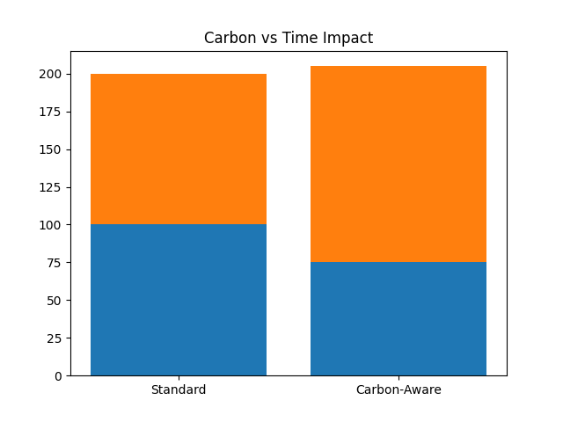
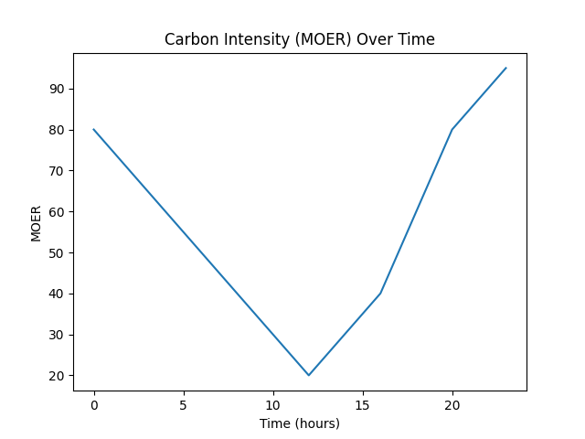
Graph Demonstration

Slide 12
Energy VS Carbon Insight
One of the most important findings of this research is that the total energy consumption of the system remained nearly the same in both traditional and carbon-aware scheduling approaches. In other words, the system did not reduce the amount of electricity used to complete tasks; instead, it changed the timing of when that energy was consumed.
This distinction is crucial because it shows that lowering carbon emissions does not necessarily require reducing computational activity or sacrificing performance. Rather, by strategically shifting workloads to periods when the electricity grid is powered by cleaner energy sources, the system can significantly reduce its environmental impact.
This insight highlights a more practical and scalable approach to sustainability. Instead of focusing solely on energy efficiency, organizations can optimize energy usage patterns, aligning computation with low-carbon energy availability. This makes carbon-aware scheduling an effective solution that balances operational needs with environmental responsibility.

Slide 13
Conclusion
The research concludes that carbon-aware scheduling is a simple yet highly impactful approach to reducing carbon emissions in modern computing systems. Unlike traditional methods that rely on upgrading hardware or improving energy efficiency, this solution works entirely at the software level by changing when tasks are executed rather than how they are executed.
Because it does not require new infrastructure, specialized equipment, or significant financial investment, it is both cost-effective and easy to implement across existing systems. This makes it especially attractive for organizations of all sizes, including those with limited resources.
Additionally, the approach is highly scalable, meaning it can be applied to small-scale systems as well as large distributed data centers. By integrating real-time carbon data into scheduling decisions, organizations can significantly reduce their environmental footprint while maintaining performance, making this a practical and accessible step toward sustainable computing.

Slide 14
Future Work
Future improvements to this system aim to make carbon-aware scheduling more intelligent, predictive, and efficient. Currently, the system reacts to real-time carbon intensity data, making decisions based only on present grid conditions.
However, by integrating weather forecasting data, the system could anticipate future availability of renewable energy sources such as solar and wind. For example, it could predict when sunlight will be strongest or when wind speeds will be highest, allowing it to plan task execution in advance rather than reacting in the moment.
In addition, incorporating machine learning algorithms would further enhance the system’s capabilities. These models could analyze historical patterns of energy production, grid behavior, and workload demands to make more accurate predictions about low-carbon periods. As a result, the scheduler could optimize task timing more effectively, reducing unnecessary delays while maximizing carbon savings.
This proactive approach would not only improve efficiency but also increase overall system reliability and performance. By planning ahead, the system can better balance execution time and environmental impact, making it smarter, more adaptive, and highly effective in promoting sustainable computing practices on a larger scale.

Slide 15
References
[1] C. Romero and S. Ventura, “Educational Data Mining: A Review of the State of the Art,” IEEE Transactions, 2013. [2] R. Buyya et al., “Energy-Efficient Management of Data Center Resources,” Future Generation Computer Systems,2010.
[3] L. Barroso and U. Hölzle, The Datacenter as a Computer, Morgan & Claypool, 2009.
[4] A. Qureshi et al., “Cutting the Electric Bill for Internet-Scale Systems,” ACM SIGCOMM, 2009.
[5] WattTime, “Real-Time Carbon Intensity Data,” [Online API Service].

Slide 16
Thank You
<number>

